Slide 1
Change Request (CR) 10361: Data Maturation in current environment
20 Oct 2020
Mr. Jonathan Wilson
AFNC3C/NGAA

Slide 2
Life Cycle of a NC3 Job control Number
UNCLASSIFIED
Mature data mining reflects job open to job completion
Discrepancy discovered and JCN created
Technician dispatched to attempt fix action
Technician completes and documents fix action
What NC3 MPI captures
What NC3 MPI Data is missing: Hours, Days, Weeks??
Platform partners secure AAIP data in hours: Type Equipment Code for NC3 components is “G” the same as Aerospace Ground Equipment and does not allow query for total sight picture
UNCLASSIFIED

Slide 3
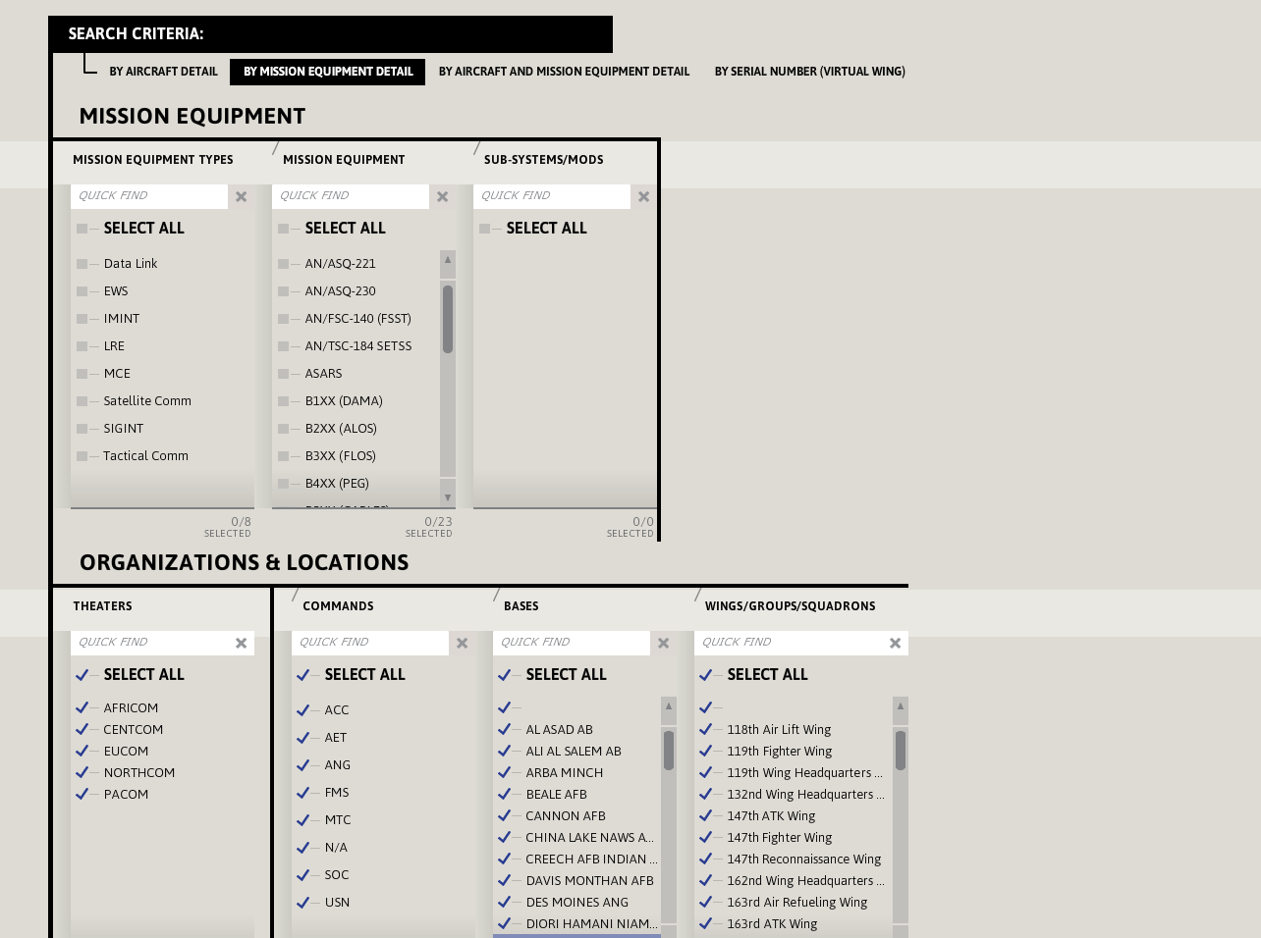
Fidelity and Expectations
UNCLASSIFIED
Insert: AN/USQ 225
Weapons System
Use Specific CS
- AN/ASC-48
- ASC-50V1
- AN/ASC-47
- AN/ASC-49
- AN/ASC-46-
Enable the user to select between each
Individual sub system within NC3
UNCLASSIFIED
Notes:
-- In a fully mature MIS all 12 Configuration Elements would be available on this screen, and data request could drill down to Constituent System level

Slide 4
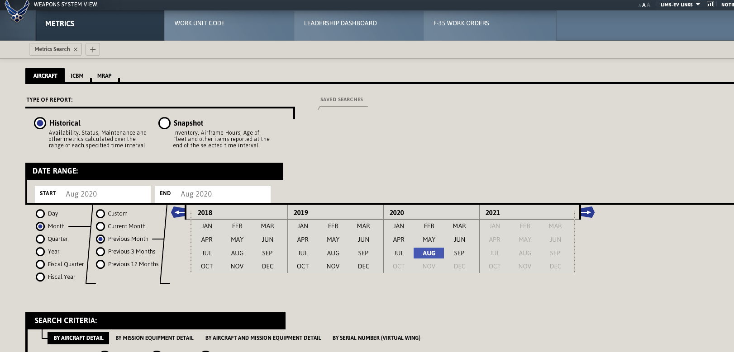
Fidelity and Expectations
UNCLASSIFIED
Install options for the user to select the time
each discrepancy was created, to time it is closed out.
Then calculate that time into each performance indicator.
UNCLASSIFIED
Notes:
This would be total downtime or the equivalent of Aircraft Availability

Slide 5
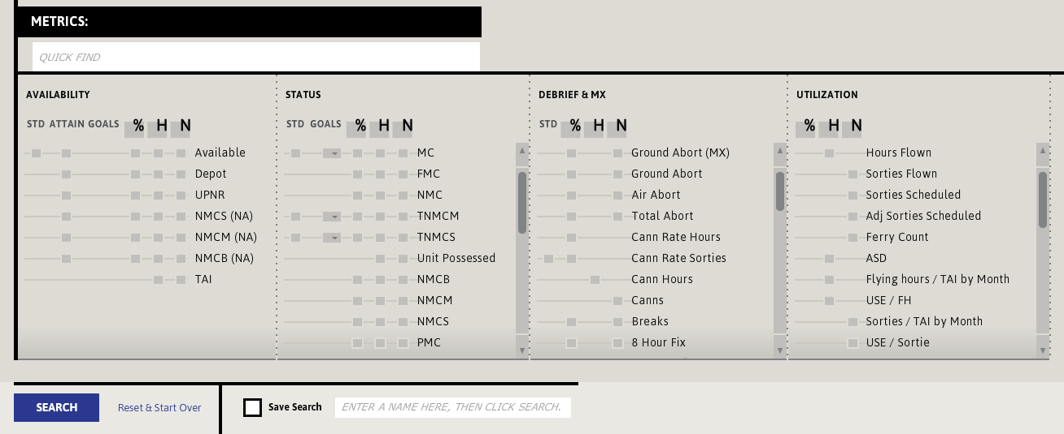
Fidelity and Expectations
UNCLASSIFIED
Current down time is based on time spent to perform maintenance i.e. “Wrench Time” and not total amount of down time for the system until FMC
UNCLASSIFIED
Notes:
Having the option to select only NC3 Systems will allow for users to then calculate each rate for the constituent systems individually and the entirety of the AN/USQ 225.
This will also decrease man hours spent using Excel products and arduous formulas to push calculations.
Current down time is based on time spent to perform maintenance i.e “Wrench Time” and not total amount of down time for the system until FMC

Slide 6
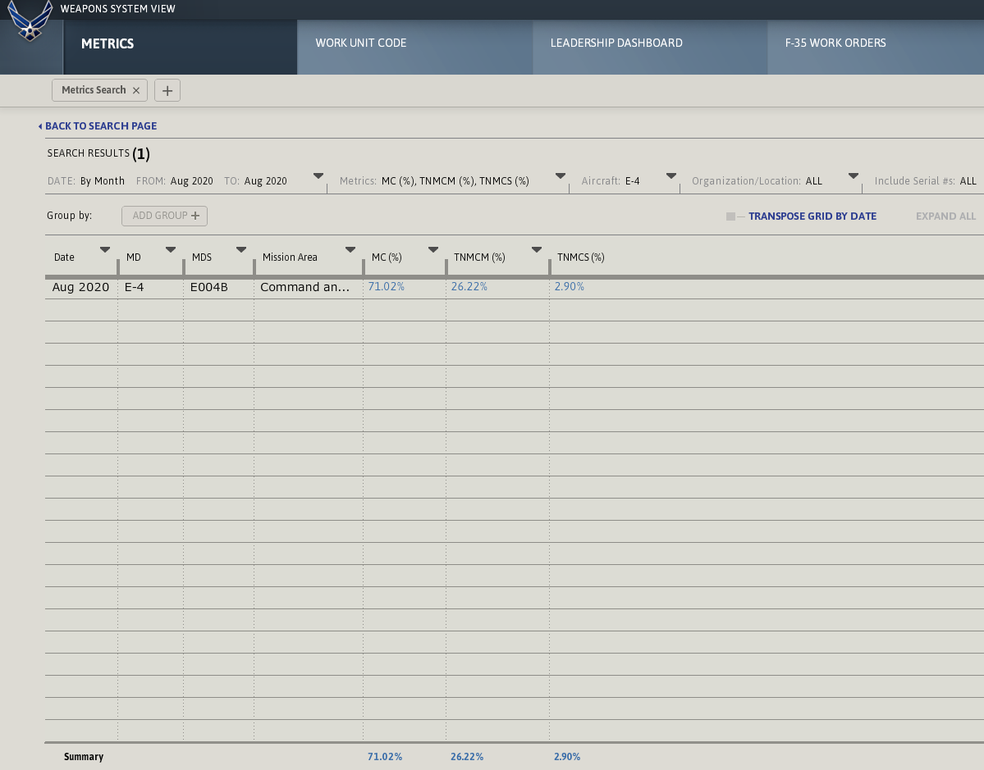
Fidelity and Expectations
UNCLASSIFIED
This view shows a percentage calculated for each driver. Currently viewed shows entire airframe not NC3 percentages
UNCLASSIFIED

Slide 7
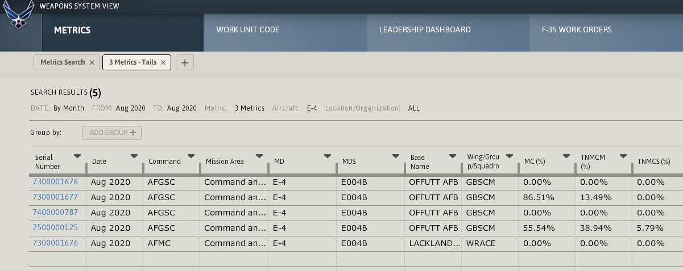
Fidelity and Expectations
UNCLASSIFIED
By selecting each driver the next option allows you to drill down to how each tail number rates within the entire system CE’s
UNCLASSIFIED

Slide 8
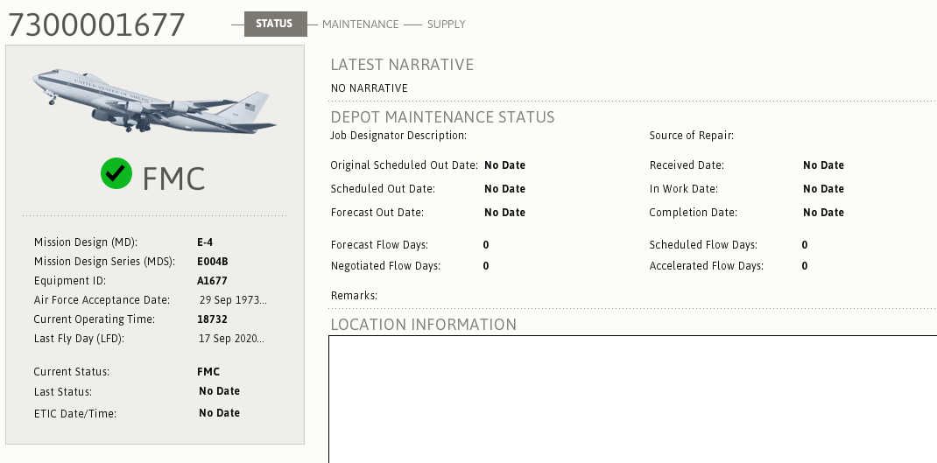
Fidelity and Expectations
UNCLASSIFIED
UNCLASSIFIED

Slide 9
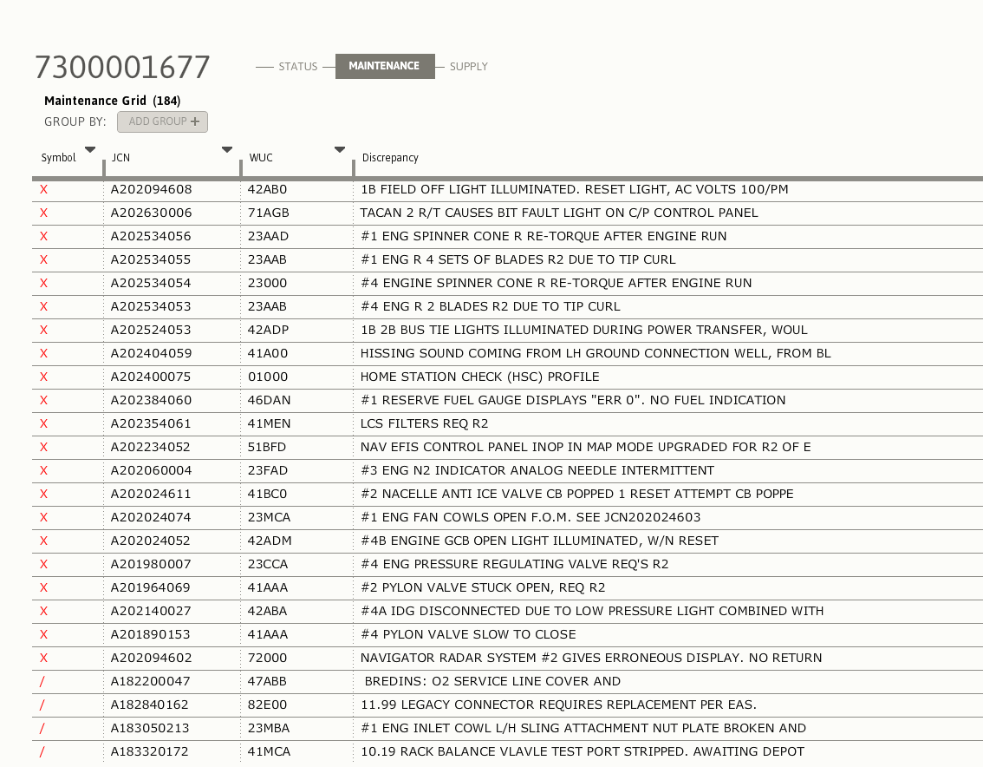
Fidelity and Expectations
UNCLASSIFIED
UNCLASSIFIED

Slide 10
Key Takeaways
UNCLASSIFIED
Data Maturity efforts have been ongoing since March 2019
Originally LIMS-EV was used until discovery of data exclusion
Cloud Migration has been detrimental to mitigation attempts
Change request has been stagnant
Empirical WS health data is unavailable until CR is implemented
Platform partners build AAIP in hours for entire A/C fleet
NC3 Weapons System aperture is reliant on data maturity efforts
MPI does give insight: An unknown portion of data is missing
Change Request fully mature in Information Systems Management tool; Awaiting Program Manager concurrence
UNCLASSIFIED

